Slide 1
Welcome To Seminar of
SPORTs TOURNAMENT SCHEDULE POC

Slide 2

Kishkinda university
ADVANCING KNOWLEDGE TRANSFORMING LIVES
DEPARTMENT OF COMPUTER SCIENCE AND ENGINEERING
PROJECT TEAM MEMBERS
NAMES:-
REG NO:
DHANUSH JADHAV
DEEPAK G
JAFFAR
JAGADESH B
SHOAIB MALLIK
K.PREM KUMAR
BTech-cse040
BTech-cse028
BTech-cse054
BTech-cse041
BTech-cse098
BTech-cse044

Slide 3

Introduction To the Sports Tournament Scheduler Poc :-
The Sports Tournament Scheduler is designed to streamline the organization and management of sports events.
It addresses the complexities involved in scheduling matches, managing teams, and facilitating communication among participants.

Slide 4
Objective:-
To automate the scheduling process of sports tournaments.- To enhance communication between organizers, teams, and players.
To provide real-time updates and notifications.
To ensure efficient resource allocation and venue management.
Existing System:-
Currently, tournament scheduling often relies on manual processes, spreadsheets, and basic software tools. This leads to:-
High chances of scheduling conflicts.
Inefficient communication among participants.
Difficulty in tracking match results and player statistics.

Slide 5
Proposed System:-
The proposed system will offer a centralized platform for:-
Scheduling matches based on team availability .
Sending automated notifications and updates.
Providing an online portal for teams to register and manage their profiles.
Integrating results and statistics tracking.
Vision:-
To create a user-friendly, efficient, and comprehensive sports tournament management system that enhances the overall experience for organizers, teams, and spectators.

Slide 6
Requirements Specification:-
1. Functional Requirements:
User registration and authentication.
Match scheduling .
Real-time score updates.
Results input and statistics tracking.
2. *Non-Functional Requirements:
Useability: Intuitive(having the ability to understand) interface for all users.
Performance: Quick response times for user actions.
Security: Data protection for user information

Slide 7
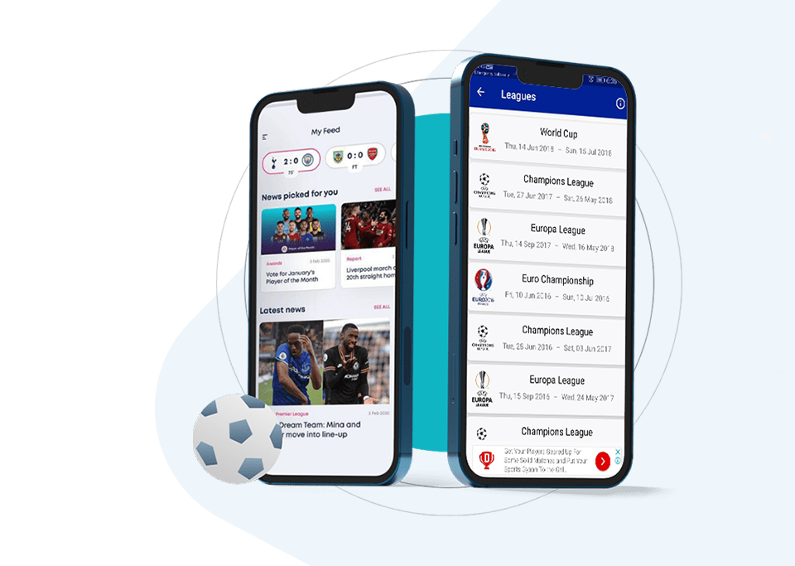

System Architecture components:-
1.User Interface(UI):- like paytm events
Web Application:- For users to interact with the system.
Login/Register:- User authentication and profile management.
Dashboard:- Overview of tournaments, upcoming matches, and notifications.
Tournament Creation:- Form for users to set up new tournaments.
Match Scheduling:- Interface to schedule matches and manage team assignments.
Notifications:- Real-time updates for team players.
2. BACKEND SERVICES:-
APP Layer:- Restful services to handle requests from the UI.
Authentication Service:- Manages user login, registration, and sessions.
Tournament Management Service:- Handles creation, updating, and deletion of tournaments.
Match Scheduling Service:- Algorithms for scheduling matches based on availability.
Notification Service:- Sends updates via email, SMS, or in-app notification

Slide 8

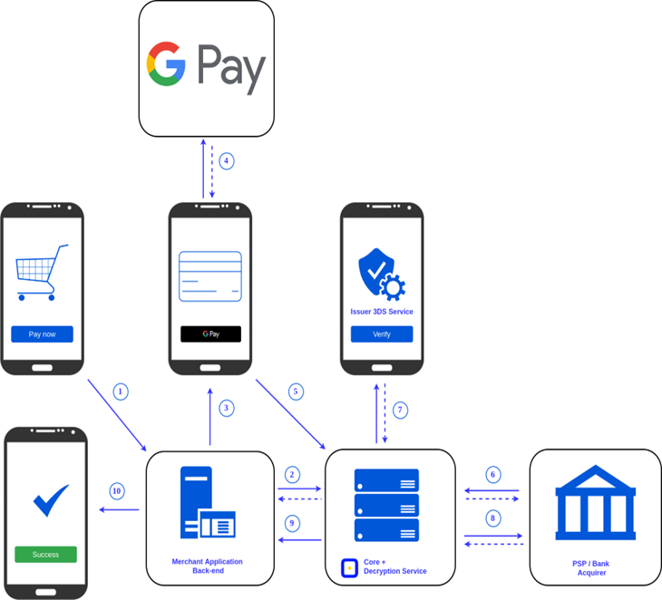
3. DATA BASE:-
User Database: Stores user information.
Tournament Database: Information about tournaments, including teams, schedules, and results.
Match Database: Details about matches, scores, and statistics.
Notification Database: Records of sent notifications and user preferences.
4. Third-Party Integrations:-
Payment Gateway: For processing tournament registration fees.
Calendar API: Sync tournaments with users' calendars (Google Calendar, Outlook, etc.).
Social Media API: Share tournament information and updates

Slide 9
Modules:-
1. User Management Module*:-
Registration, login, and profile management.
2. *Scheduling Module*:-
Match scheduling, venue assignment, and conflict resolution.
3. *Notification Module*:-
Automated alerts for teams and participants.
4. *Results Management Module*:-
Input and display match results and statistics.
5. *Reporting Module*:-
Generate reports on team performance, match history, etc.
OUTPUT:-
A fully functional web or mobile application that facilitates tournament management, with features for scheduling, notifications, and results tracking.

Slide 10
Conclusion:-
The Sports Tournament Scheduler aims to revolutionize how sports tournaments are organized, providing a systematic approach to scheduling and communication, ultimately leading to more successful and enjoyable events.
Benefits:-
Improved efficiency in scheduling and resource management.
Enhanced communication among all stakeholders.
Accurate tracking of results and statistics.
A better experience for players and spectators.
References:-
Research papers on sports management systems.
Existing tournament management software for benchmarking.
User feedback from current tournament organizers and participants.

Slide 11


